Slide 1
ArcGIS CrashCourse
By: Mason Mappers

Slide 2
Easy Steps To Follow
Planning
Get Your Data
Navigate Your Interface
Data Control/Visualization
Context

Slide 3
Planning
Intent of the Map
Audience
Theme
Intended Message
What makes your map complete?
Project
Stand-alone
User Decision

Slide 4
Today’s Map
Stand-alone map
Uses Impervious Surfaces Data From Fairfax County Open Data Portal
Helping establish an after-school program for fairfax county
To be placed on their website
Location must be within 5 miles, closer the better
Elementary, Middle, & High School programs

Slide 5
Fairfax County Open Data
After planning, you need data

Slide 6
Side Note
Most data can be found if you google the local governments open data portal
Example: Fairfax, Arlington, DC, etc.
You can also request data access if you have a relevant project.
Usually more lenient towards students
EX: Beekeeper hive locations (https://beecheck.org/)
DO NOT ABUSE DATA ACCESS!

Slide 7
https://www.fairfaxcounty.gov/maps/open-geospatial-data

Slide 8
Files Needed

Slide 9
What it looks like in ArcMap

Slide 10
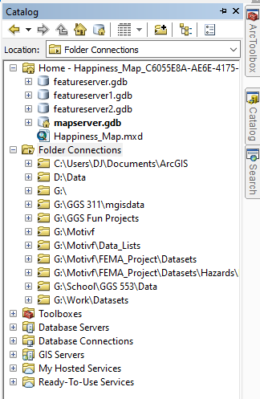
What it looks like in ArcMap
Add data Button
Catalog

Slide 11
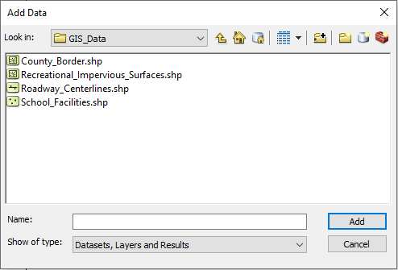
What it looks like in ArcMap
Add Data

Slide 12
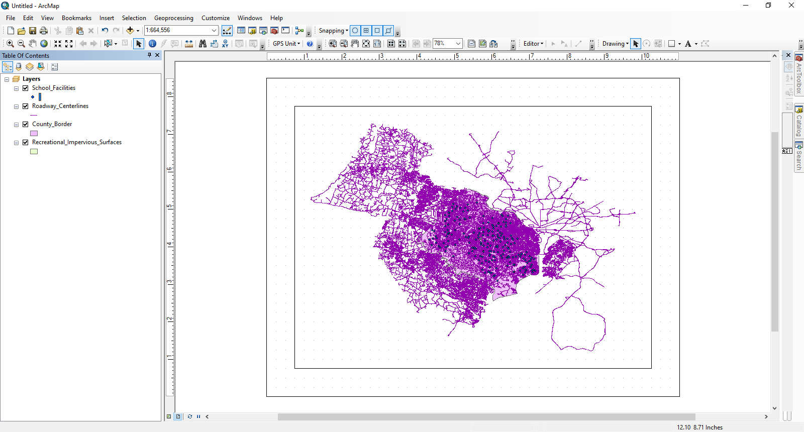
Ugliness in ArcMap
DON’T WORRY, IT WILL BE ALRIGHT!!!

Slide 13
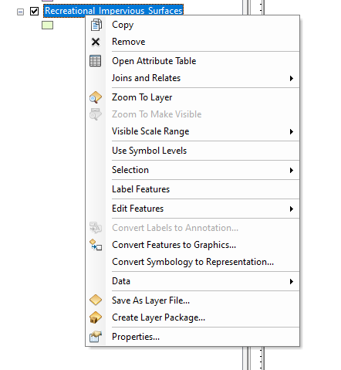
Attribute Tables Are Friends
Attribute Table
Select

Slide 14
Attribute Tables Are Friends
Options
The Good Stuff (Your Data)
Name of Table

Slide 15
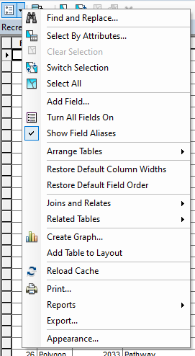
Attribute Tables Are Friends
Select By Attributes
Using a Query to find the data we’re going to use

Slide 16
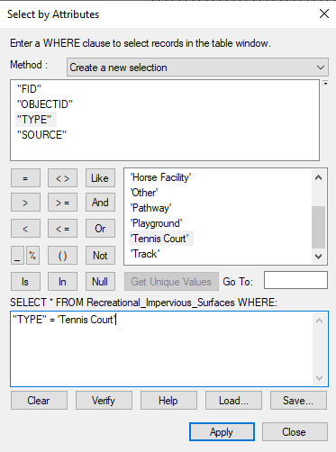
Attribute Tables Are Friends
Select it to affect it!
Use “Get Unique Values”

Slide 17
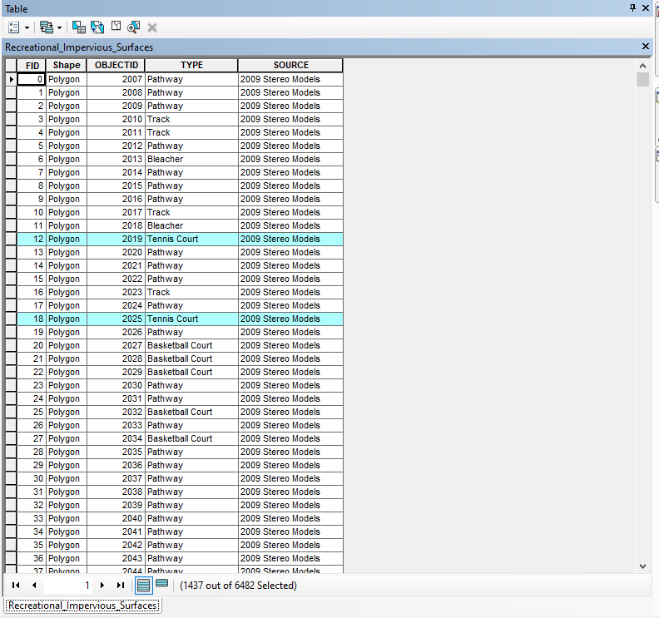
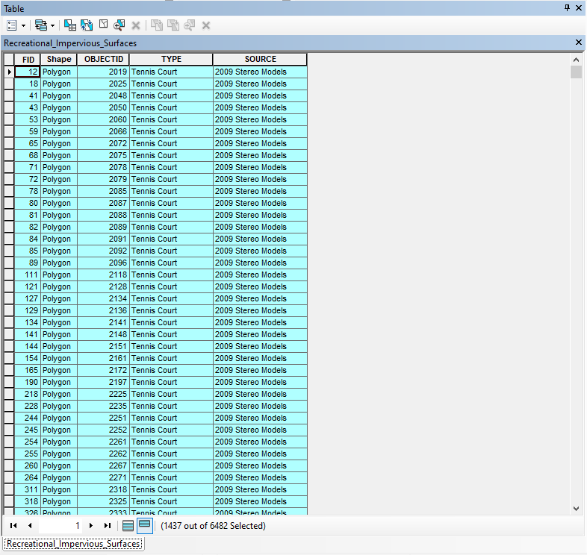
Attribute Tables Are Friends

Slide 18
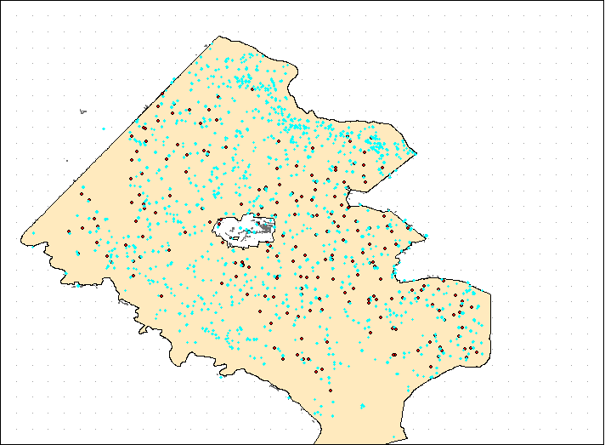
What it looks like in ArcMap
Blue are Selection Features

Slide 19
We’re done, have a nice day…
NOPE!
Complete the mission!

Slide 20
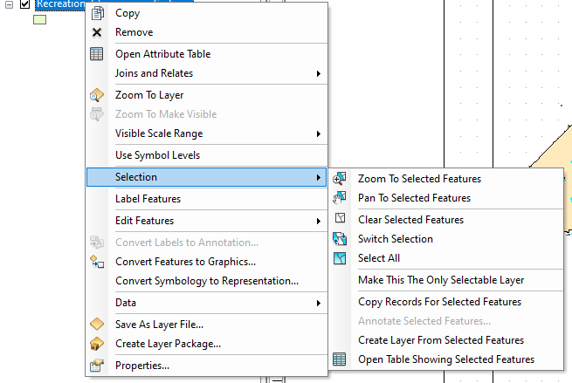
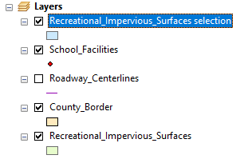
What it looks like in ArcMap
Make the Selection A Layer
Create Layer From Selected Features
Visualize your feature extraction

Slide 21
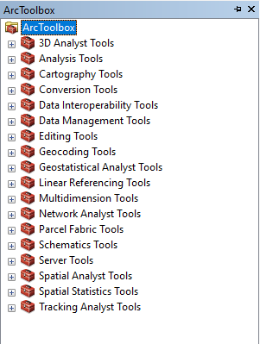
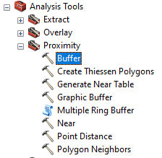
Analysis in ArcMap
Use the Buffer Tool
Create 5 mi Buffer
Schools
Impervious Surfaces

Slide 22
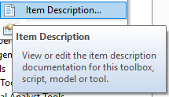
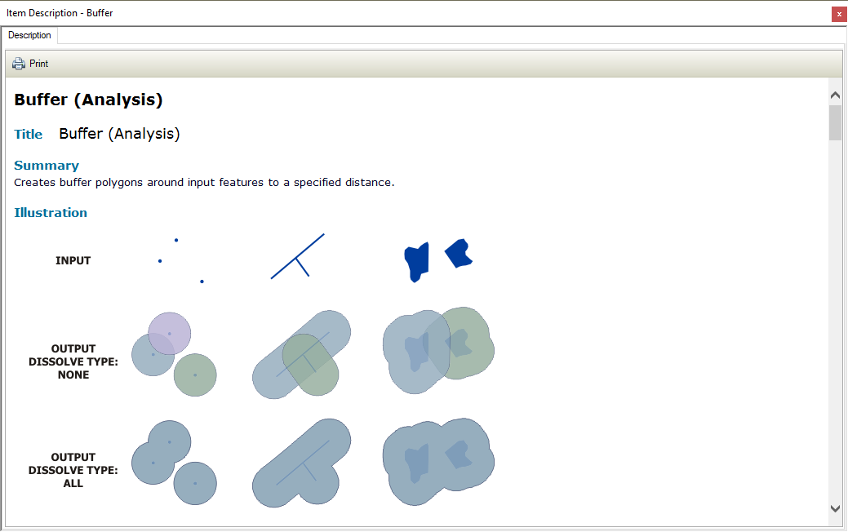
Analysis in ArcMap
Tools have Descriptions!

Slide 23
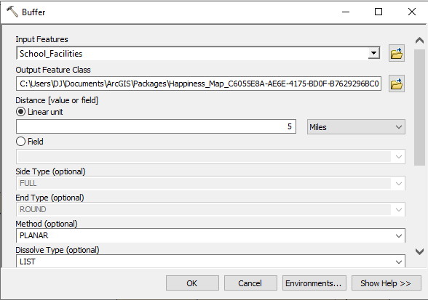
Analysis in ArcMap
Input: Schools
Unit: 5 Mi

Slide 24
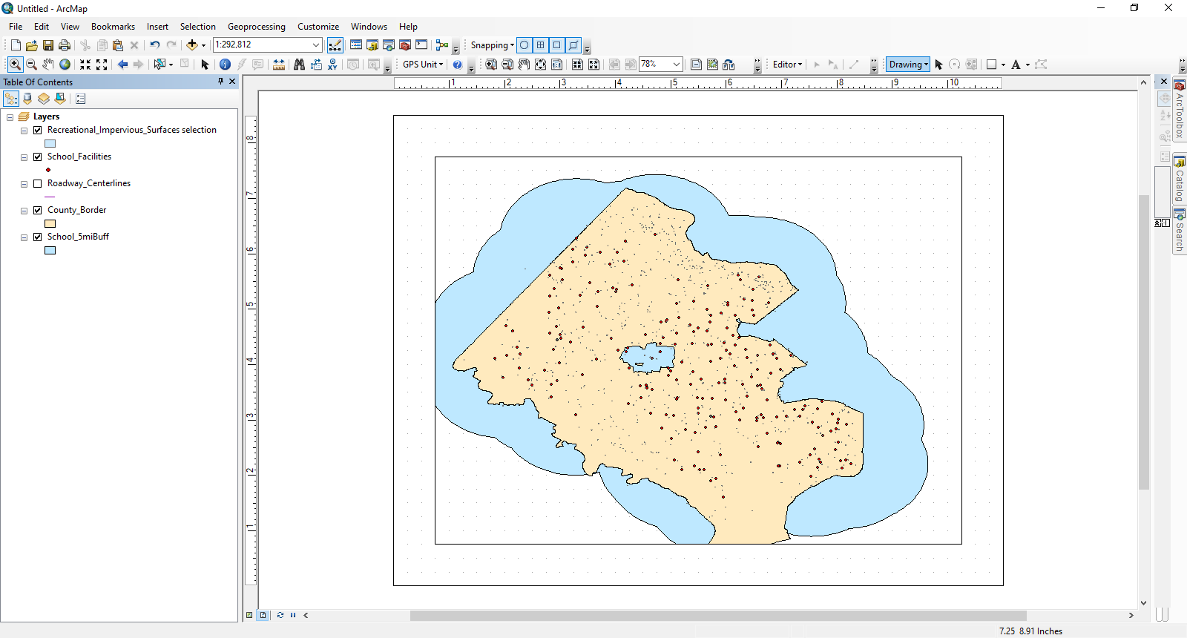
What is this!?!?!?....

Slide 25
Try Again
Play with the parameters for the buffer tool
See what works for you!
AKA, you’re the analyst…so analyze and problem solve!
You can’t break the data so no worries ☺
(That’s a white lie but it’s really hard to break the data)

Slide 26
How did yours look?

Slide 27
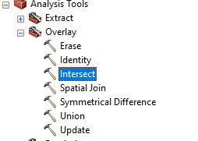
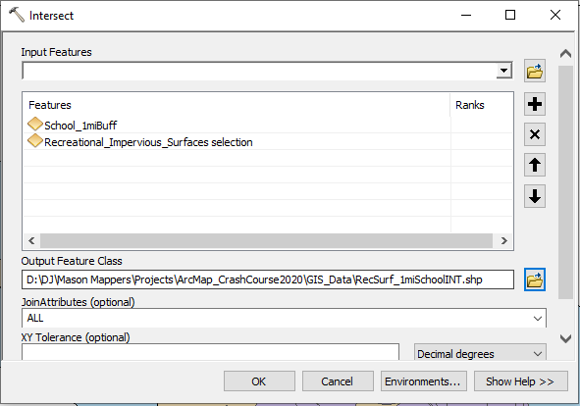
Time to Make Sense
Tool: Intersect

Slide 28
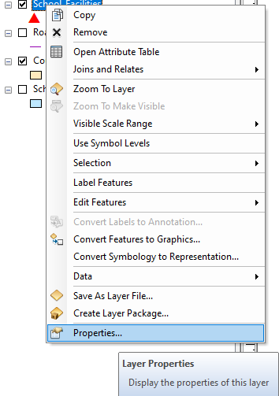
Make It Look Good
Need to see your Layers
Select it to Affect it!
Symbology

Slide 29
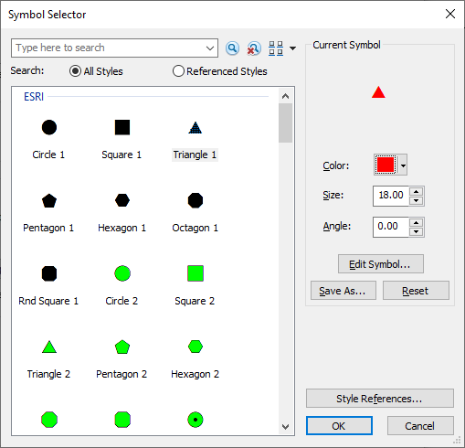
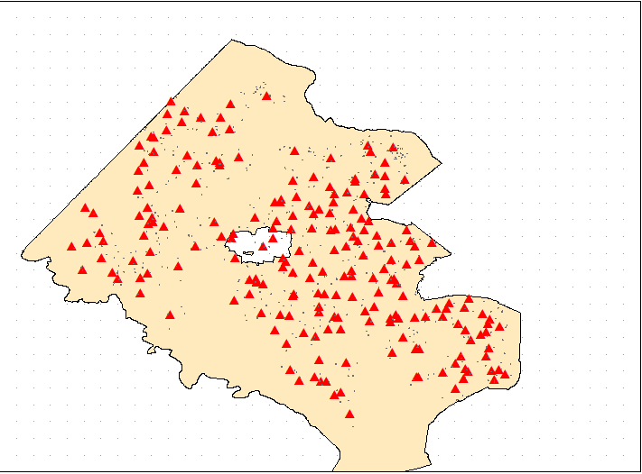
Make It Look Good
Pick a Symbol that works for you!

Slide 30
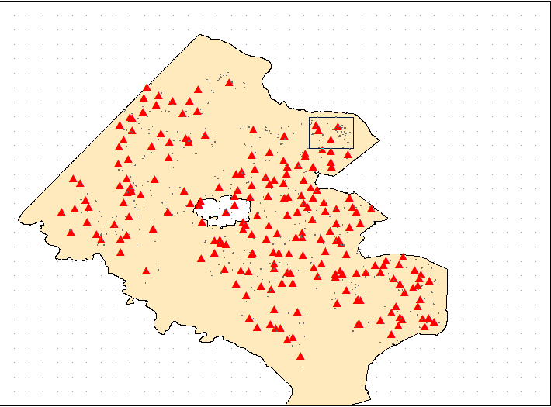
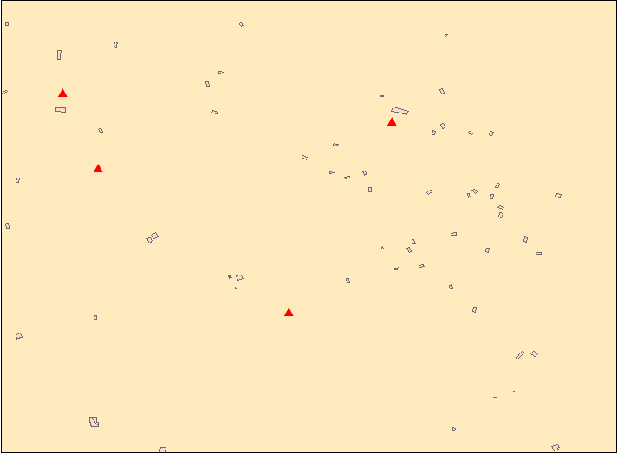
Make It Look Good
Take a closer look! (Zoom)

Slide 31
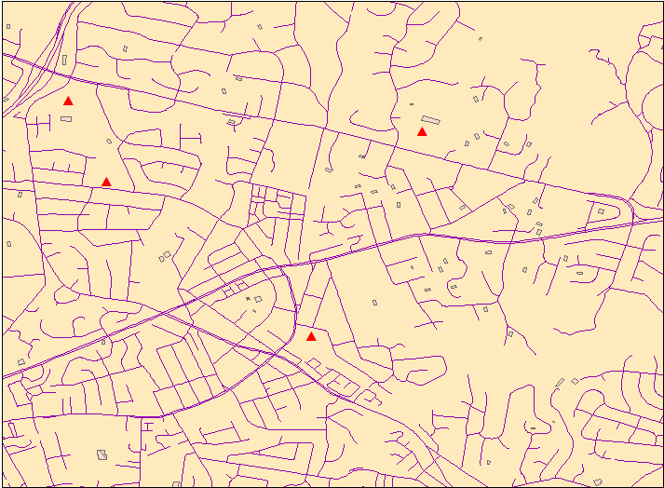
Make It Look Good
Add your roads back in to provide context
Identify or Select for information

Slide 32
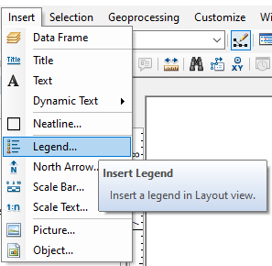
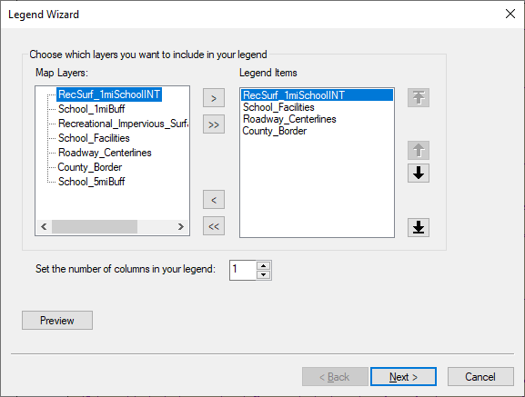
Context is Everything
Layout View (Bottom Left)
Insert a legend into your map

Slide 33
Context is Everything
Maps Need the following:
Title
Legend
North Arrow
Scale
Author
Date
Datum (Don’t worry about it for now)
Source Data/Link

Slide 34
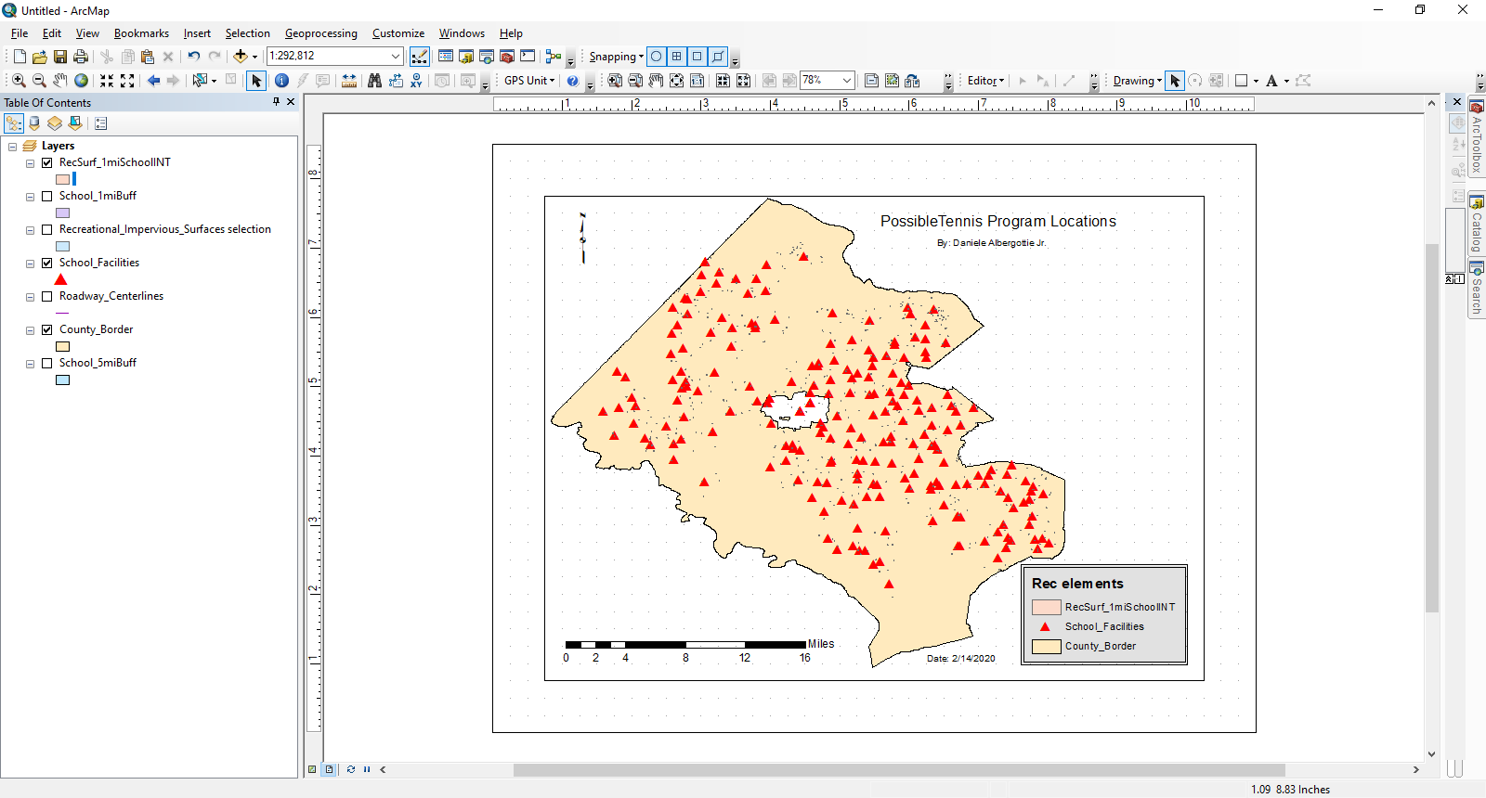
Everything Comes Together

Slide 35
What do you want?
You got the building blocks, go and expand on this project or make your own!
Some things to think about:
Time management
Will I be able to make what I want in the given amount of time?
Clarity
Can’t use a map if you can’t read it. Avoid too much and too little

Slide 36
Questions?

Slide 37
Helpful Links
EPA (https://edg.epa.gov/metadata/catalog/main/home.page)
EPA Walkability Index
https://edg.epa.gov/metadata/catalog/search/resource/details.page?uuid=%7B251AFDD9-23A7-4068-9B27-A3048A7E6012%7D
NatureServe (http://geohub-natureserve.opendata.arcgis.com/)
Species Distribution
http://geohub-natureserve.opendata.arcgis.com/datasets/richness-of-imperiled-species-in-the-united-states
NGA – Arctic (https://arctic-nga.opendata.arcgis.com/)
Arctic sea Routes
https://arctic-nga.opendata.arcgis.com/datasets/arctic-sea-routes
Government Data (https://www.data.gov/)
Virginia Atlantic Coast Recreational Use
https://catalog.data.gov/dataset/virginia-atlantic-coast-recreational-use

